Slide 1
Combined Genetic Algorithms and Neural Network
Genetic-Neural System (GNS)
To improve the performance of an NN using a GA.

Slide 2
Approaches
Approach 1: - GA-based tuning of connecting weights, bias values and other parameters
Biological Adaptation: Evolution and Learning
Concept of Evolutionary Robotics
Comparisons with BPNN

Slide 3
Approaches (Contd.)
Approach 2:- GA-based tuning of neural network topologies
Topology is decided by the number of hidden layer(s) and no. of neurons present in the hidden layer(s)
Variable string-length GA

Slide 4
Working Principle of GNS

Slide 5
Error in prediction of k-th output neuron
Total error in prediction considering all the output neurons

Slide 6
A typical GA-string:
1 0 0 1 . . 11 . . . . 0 1 1 . . 1 1 1 1 1 . . 0 1 . . . . 1 1 0 . . 1 1
1 1 . . 0 1 0 1 . . 1 1
v₁₁
v_{MN}
w₁₁
w_{NP}
a₁
a₂

Slide 7
Batch Mode of Training
Fitness of the GA-string
where L: No. of training scenarios

Slide 9
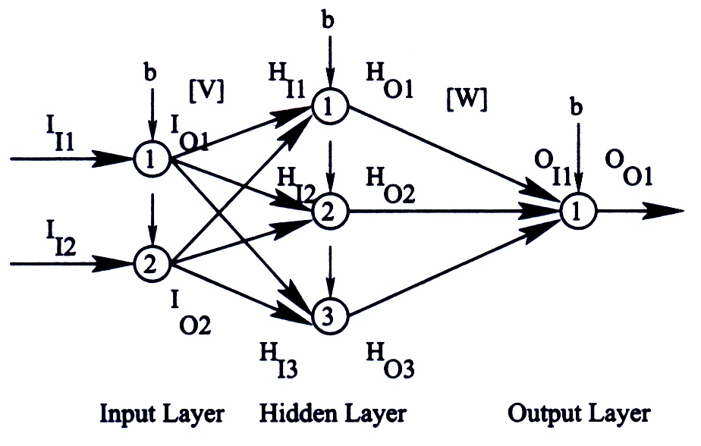
Numerical Example
A binary-coded GA is to be used to update the connecting weights, bias value and coefficients of transfer functions of an NN shown in the figure given below.
A 2-3-1 fully connected feed-forward NN

Slide 10
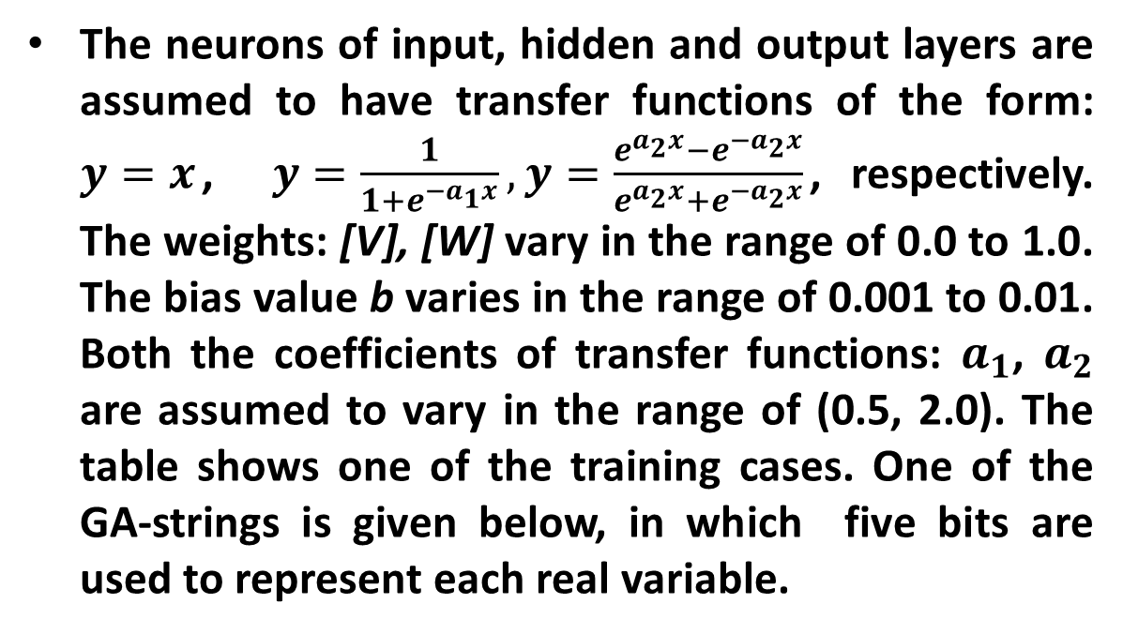
The neurons of input, hidden and output layers are assumed to have transfer functions of the form: $y=x$, $y=\frac{1}{1+e^{−a_{1}x}}, y=\frac{e^{a_{2}x}−e^{−a_{2}x}}{e^{a_{2}x}+e^{−a_{2}x}}$, respectively. The weights: [V], [W] vary in the range of 0.0 to 1.0. The bias value b varies in the range of 0.001 to 0.01. Both the coefficients of transfer functions: $a_{1}$, $a_{2}$ are assumed to vary in the range of (0.5, 2.0). The table shows one of the training cases. One of the GA-strings is given below, in which five bits are used to represent each real variable.

Slide 11
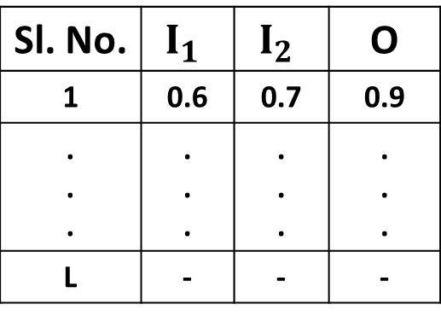
Table: Training cases
Sl. No. | $$I_{1}$$ | $$I_{2}$$ | O
1 | 0.6 | 0.7 | 0.9
. . . | . . . | . . . | . . .
L | - | - | -
Determine the deviation in prediction for the training case shown in the above table, corresponding to the above GA-string.

Slide 12
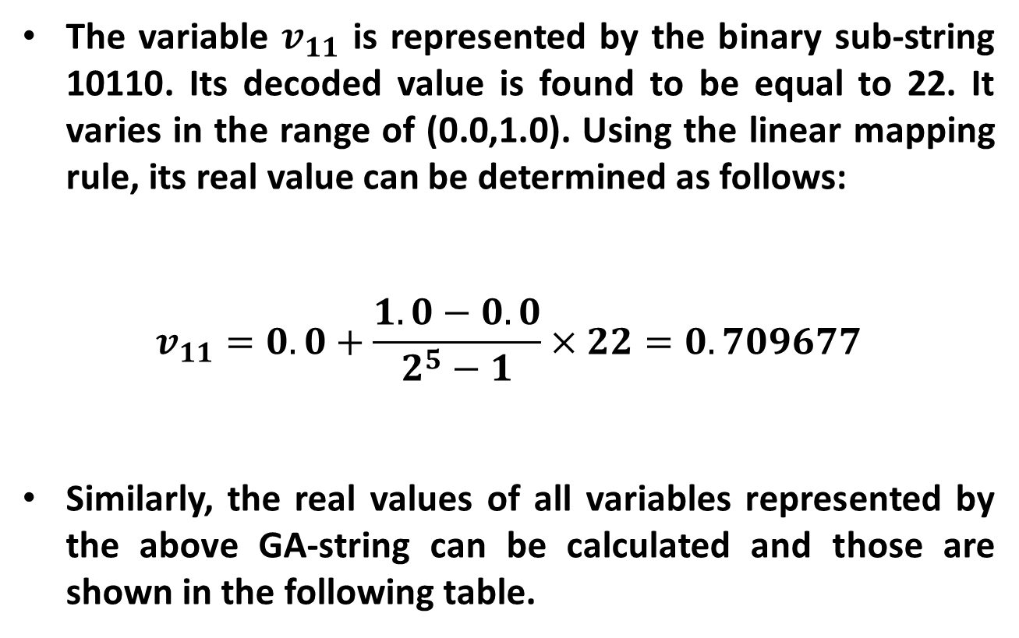
Solution:
The variable $v_{11}$ is represented by the binary sub-string 10110. Its decoded value is found to be equal to 22. It varies in the range of (0.0,1.0). Using the linear mapping rule, its real value can be determined as follows:
$$v_{11}=0.0+\frac{1.0−0.0}{2^{5}−1}×22=0.709677$$
Similarly, the real values of all variables represented by the above GA-string can be calculated and those are shown in the following table.

Slide 13
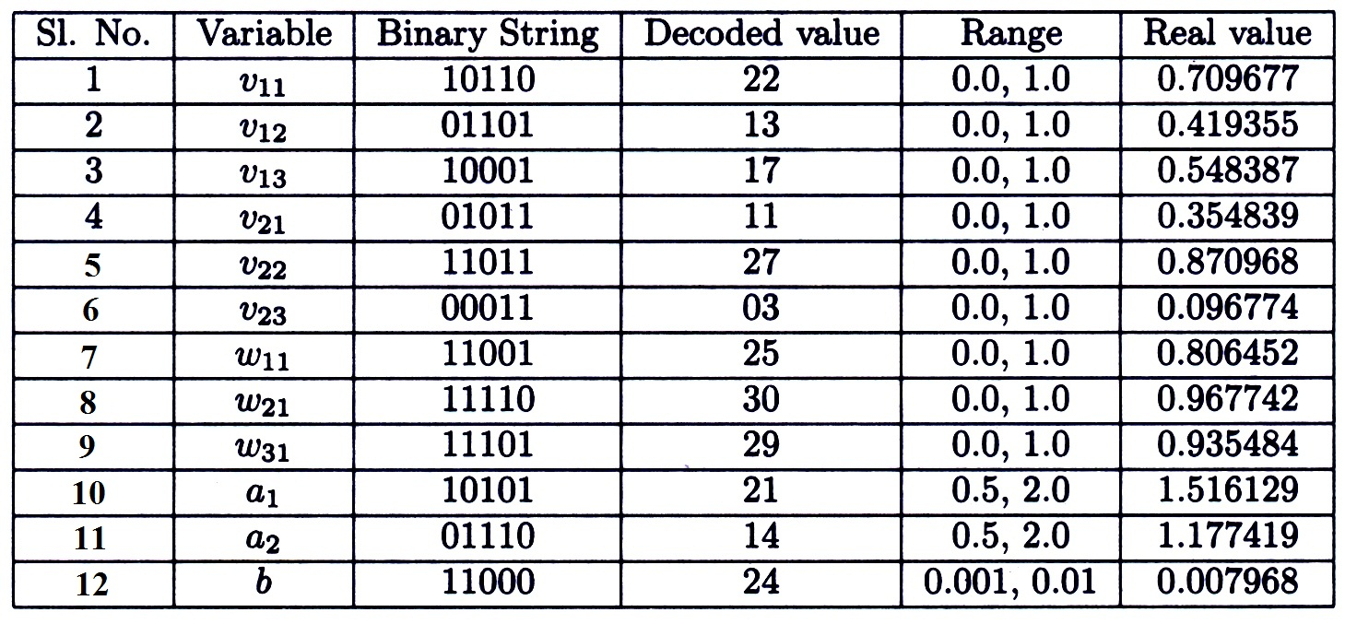
Table: Real values of the variables represented by a GA-string

Slide 14
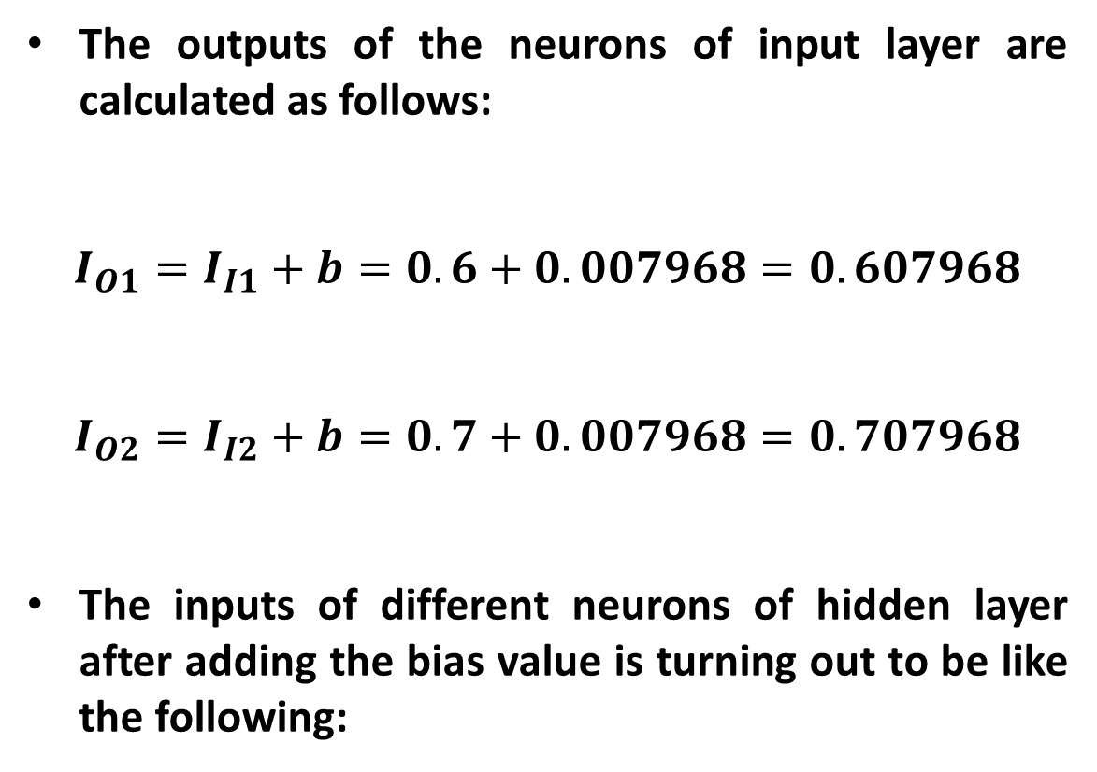
The outputs of the neurons of input layer are calculated as follows:
$$I_{O1}=I_{I1}+b=0.6+0.007968=0.607968$$
$$I_{O2}=I_{I2}+b=0.7+0.007968=0.707968$$
The inputs of different neurons of hidden layer after adding the bias value is turning out to be like the following:

Slide 15
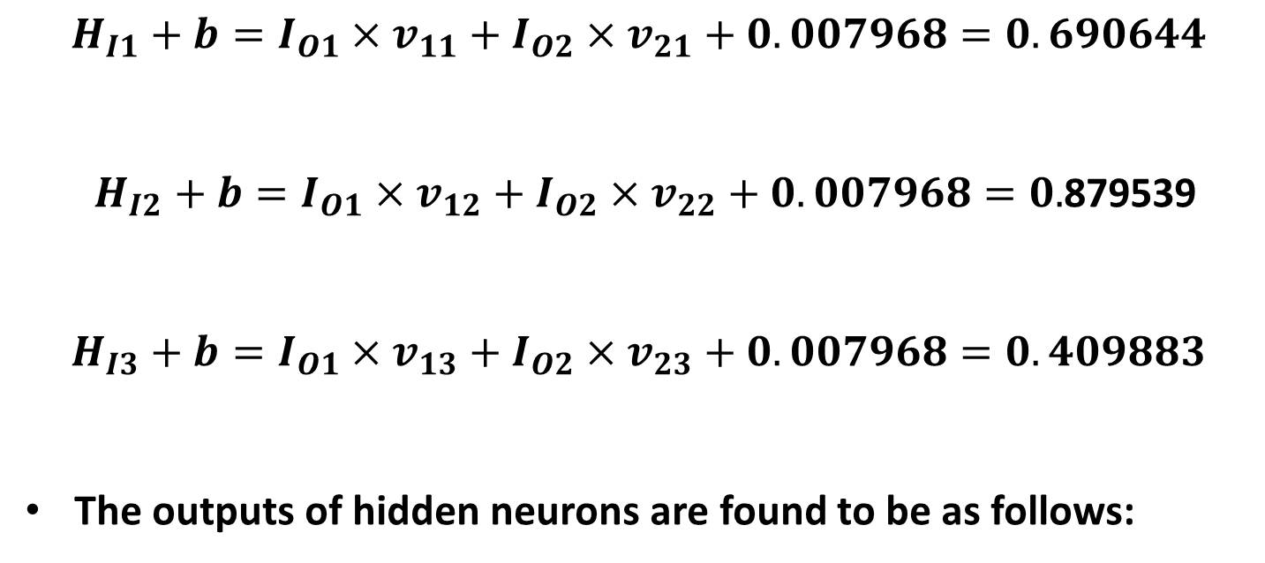
$$H_{I1}+b=I_{O1}×v_{11}+I_{O2}×v_{21}+0.007968=0.690644$$
$H_{I2}+b=I_{O1}×v_{12}+I_{O2}×v_{22}+0.007968=0.$879539
$$H_{I3}+b=I_{O1}×v_{13}+I_{O2}×v_{23}+0.007968=0.409883$$
The outputs of hidden neurons are found to be as follows:

Slide 16
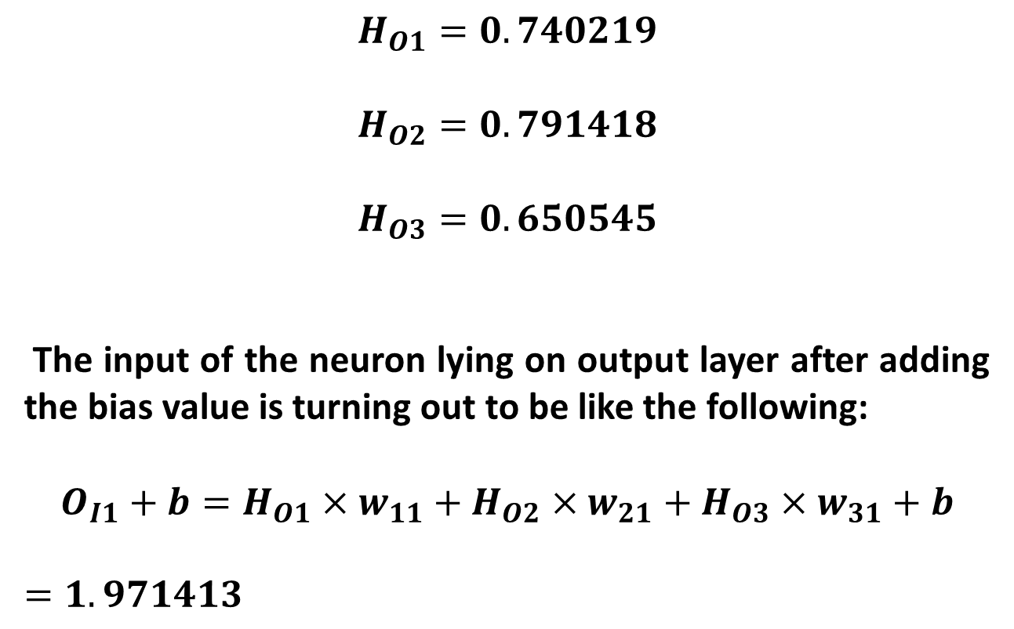
$$H_{O1}=0.740219$$
$$H_{O2}=0.791418$$
$$H_{O3}=0.650545$$
The input of the neuron lying on output layer after adding the bias value is turning out to be like the following:
$$O_{I1}+b=H_{O1}×w_{11}+H_{O2}×w_{21}+H_{O3}×w_{31}+b$$
$=1.971413$

Slide 17
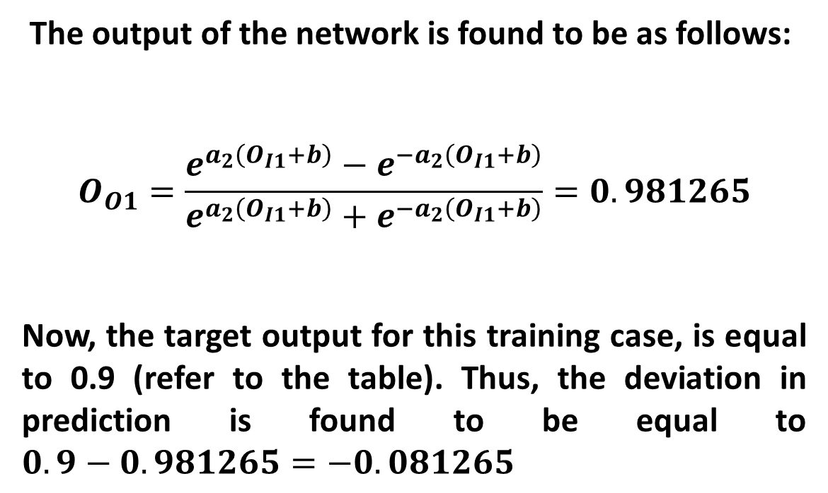
The output of the network is found to be as follows:
$$O_{O1}=\frac{e^{a_{2}\left(O_{I1}+b\right)}−e^{−a_{2}\left(O_{I1}+b\right)}}{e^{a_{2}\left(O_{I1}+b\right)}+e^{−a_{2}\left(O_{I1}+b\right)}}=0.981265$$
Now, the target output for this training case, is equal to 0.9 (refer to the table). Thus, the deviation in prediction is found to be equal to $0.9−0.981265=−0.081265$

Slide 18
Conclusion:
Optimization/Evolution of NNs using a GA: Genetic-Neural System

Slide 19
Topic
Neuro-Fuzzy Systems

Slide 20
Concepts Covered:
Neuro-Fuzzy System (Mamdani Approach)
Neuro-Fuzzy System (Takagi & Sugeno’s Approach)

Slide 21
Combined Neural Networks and Fuzzy Logic
Neural Networks have been combined with Fuzzy Logic technique in two different ways:
1. Neuro-Fuzzy System (NFS)
A Fuzzy Logic Controller (FLC) is represented using the structure of an NN and trained using either a BP algorithm or a GA

Slide 22
2. Fuzzy Neural Network (FNN)
The Neurons of an NN has been designed using the concept of fuzzy set theory
An FNN has been developed in the following ways:
Real inputs but fuzzy weights
Fuzzy inputs but real weights
Fuzzy inputs and fuzzy weights

Slide 23
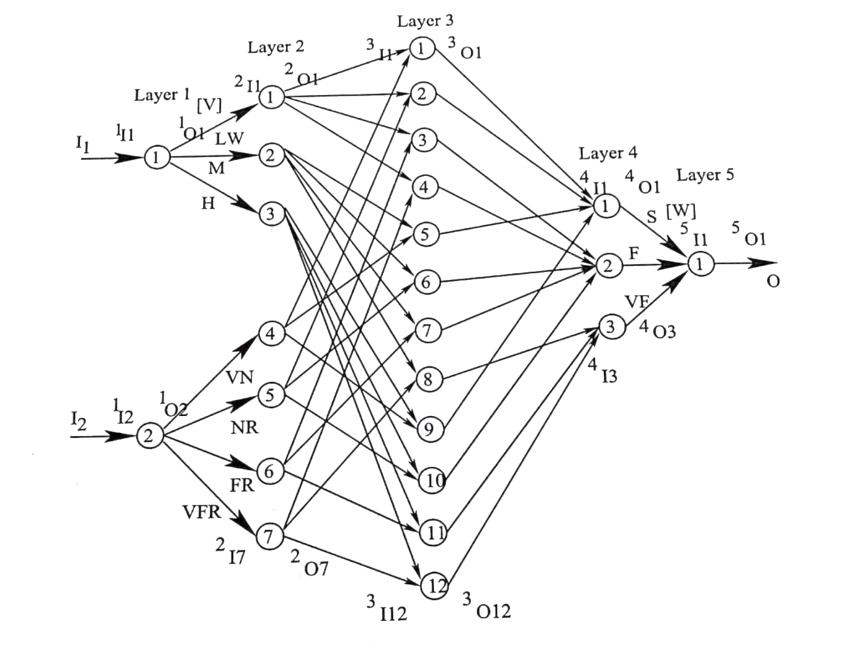
Neuro-Fuzzy System (NFS) based on Mamdani Approach
Layer 1: Input Layer
Layer 2: Fuzzification
Layer 3: AND operation
Layer 4: Fuzzy Inference
Layer 5: Defuzzification

Slide 24
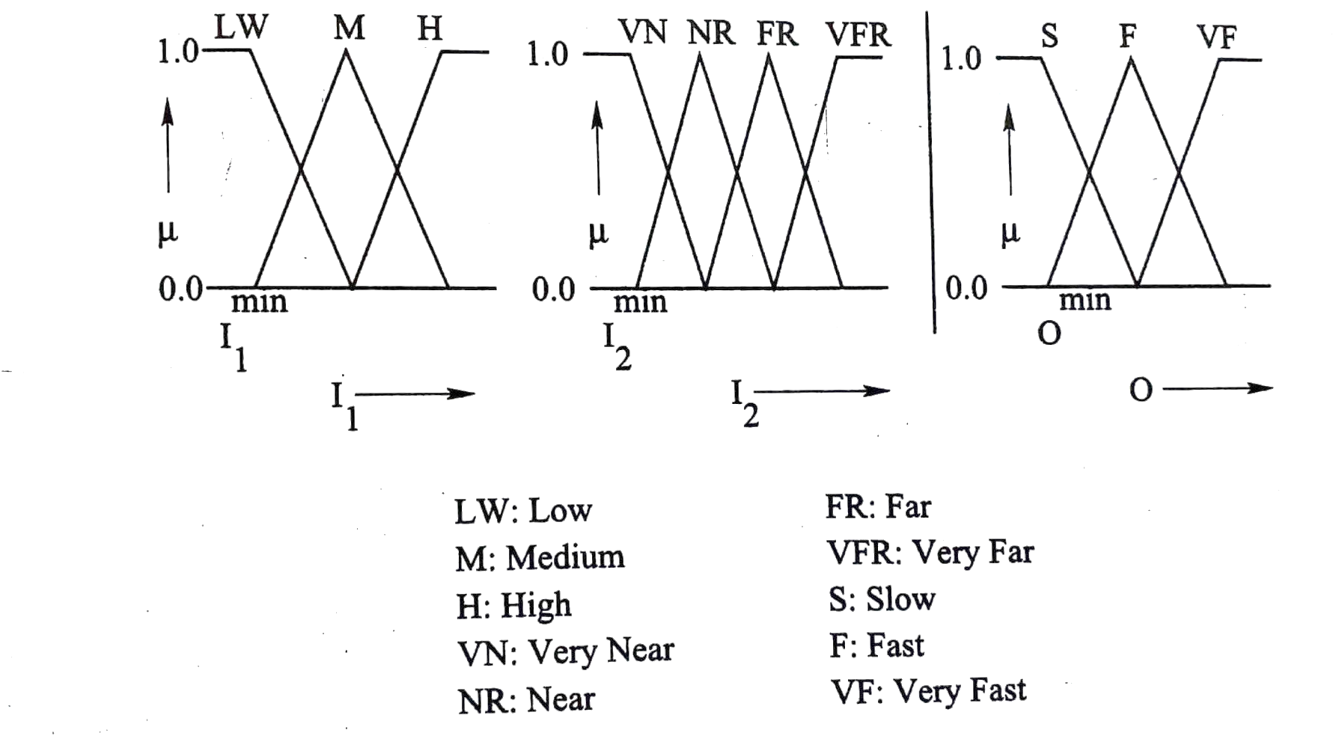
Membership Function Distributions

Slide 25
Rule Base
I₂
VN NR FR VFR
LW
M
H
S | S | F | F
S | F | F | VF
S | F | VF | VF
I₁

Slide 26
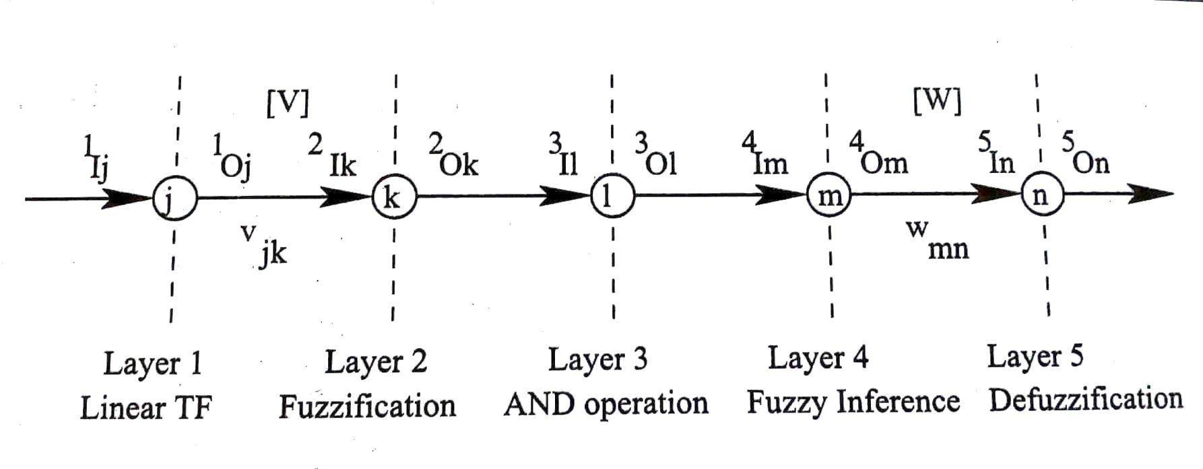
A Specific Neuron at Each Layer of the NN

Slide 27
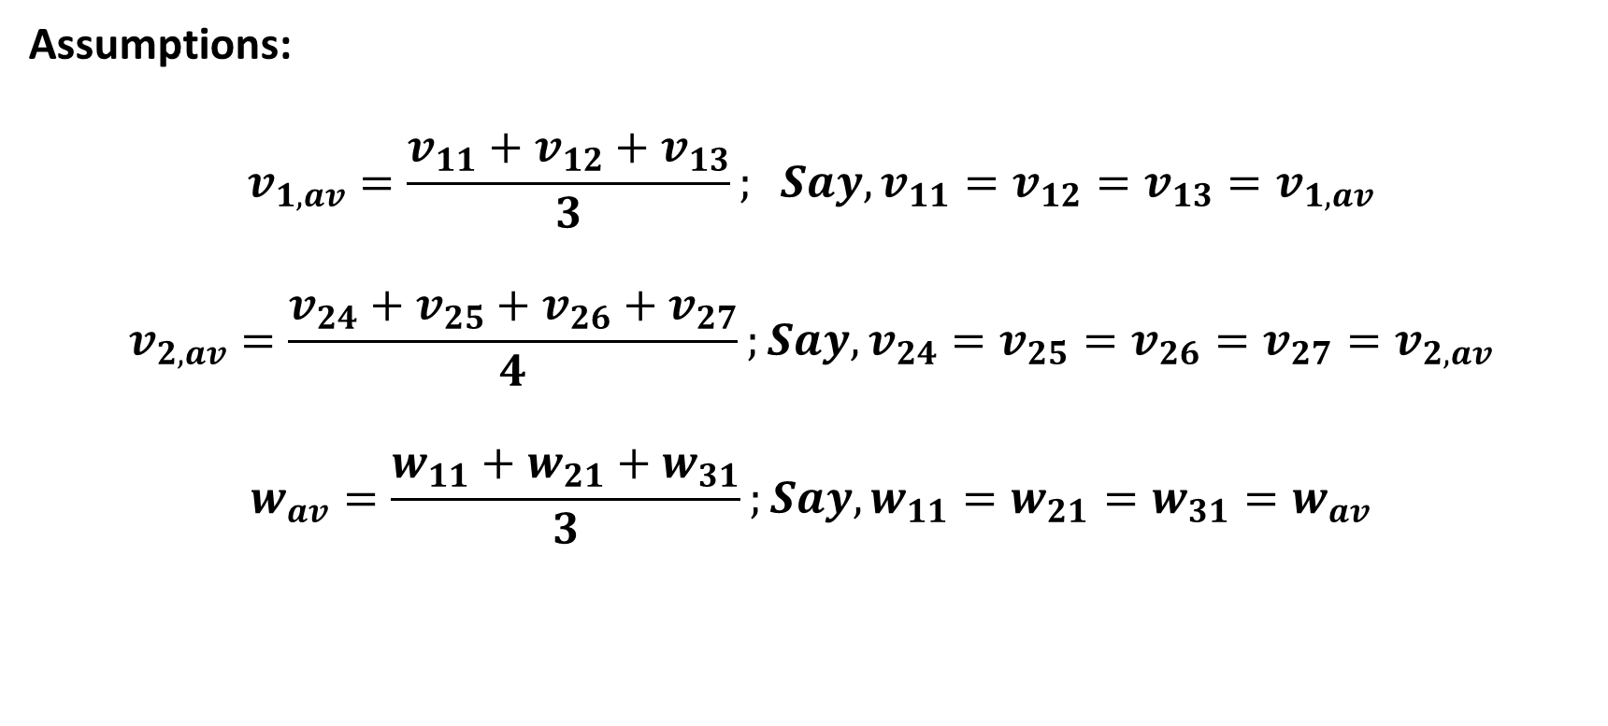
Assumptions:
$$v_{1,av}=\frac{v_{11}+v_{12}+v_{13}}{3}; Say,v_{11}=v_{12}=v_{13}=v_{1,av}$$
$$v_{2,av}=\frac{v_{24}+v_{25}+v_{26}+v_{27}}{4};Say,v_{24}=v_{25}=v_{26}=v_{27}=v_{2,av}$$
$$w_{av}=\frac{w_{11}+w_{21}+w_{31}}{3};Say,w_{11}=w_{21}=w_{31}=w_{av}$$

Slide 28
Functions of Different Layers of the NN
Layer 1: Linear TF outputs are the same with the
corresponding inputs
Layer 2: Fuzzification

Slide 29
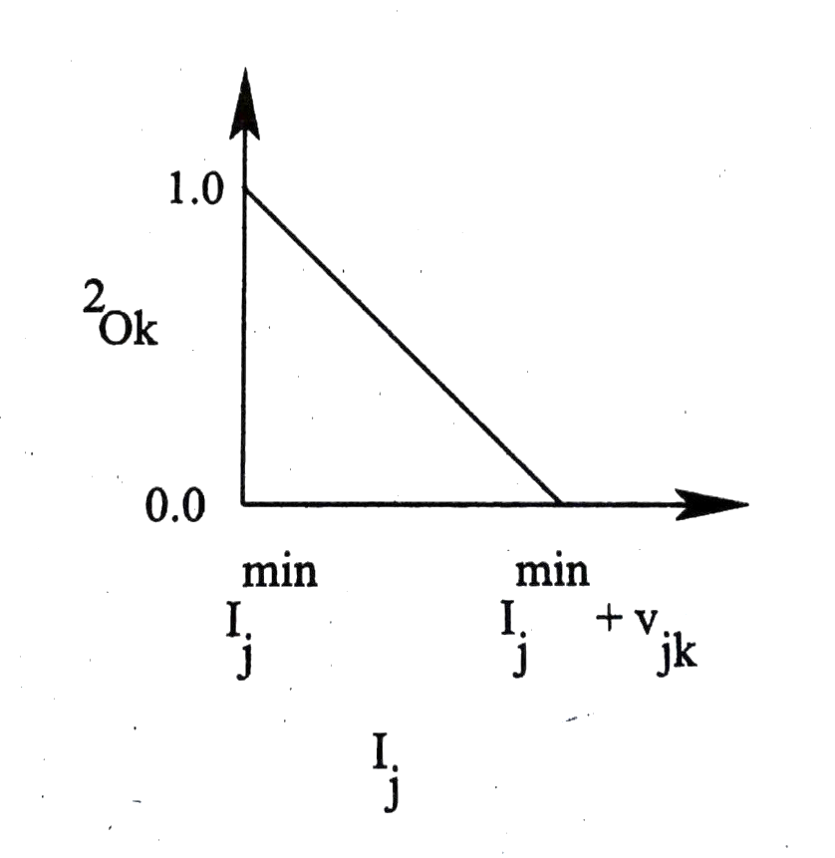
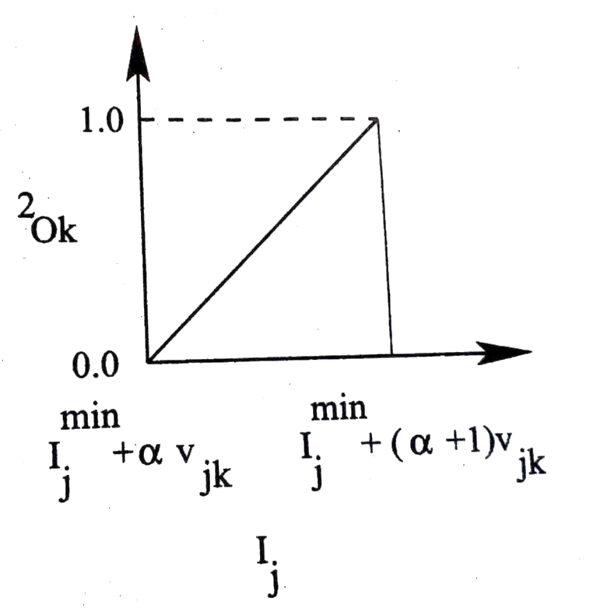
Possibilities
Right–angled triangles

Slide 30
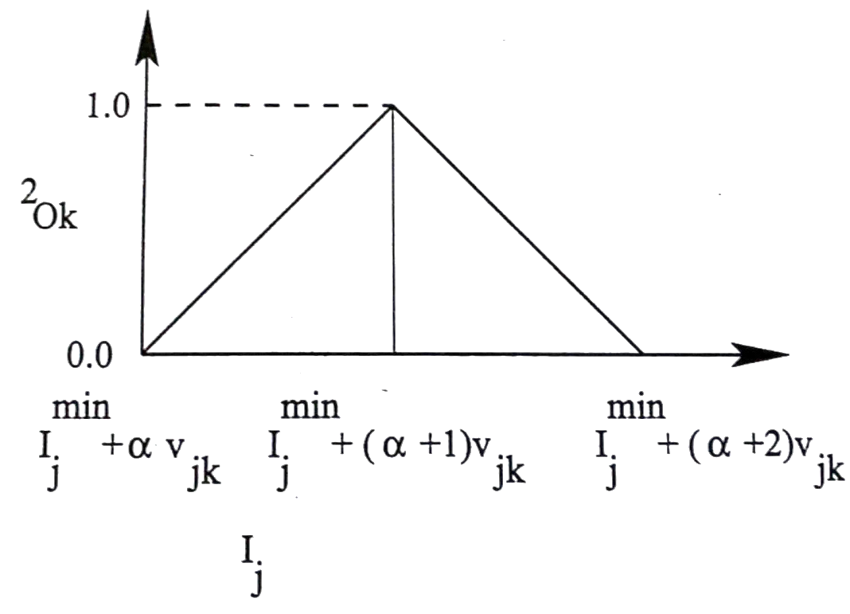
Isosceles triangle

Slide 31
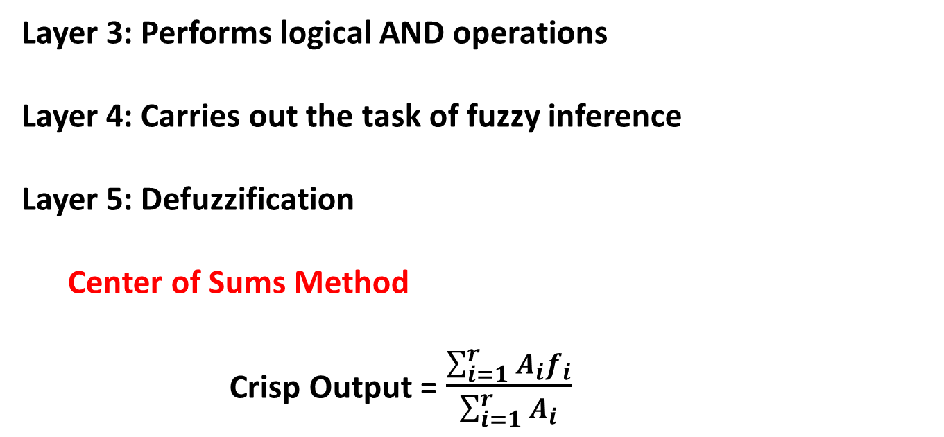
Layer 3: Performs logical AND operations
Layer 4: Carries out the task of fuzzy inference
Layer 5: Defuzzification
Center of Sums Method
Crisp Output =$\frac{\sum_{i=1}^{r}{A_{i}f_{i}}}{\sum_{i=1}^{r}{A_{i}}}$

Slide 32
Tuning of NFS
Batch mode of training
BP algorithm
Nature-inspired Optimization Tool
say Genetic Algorithm (GA)

Slide 33
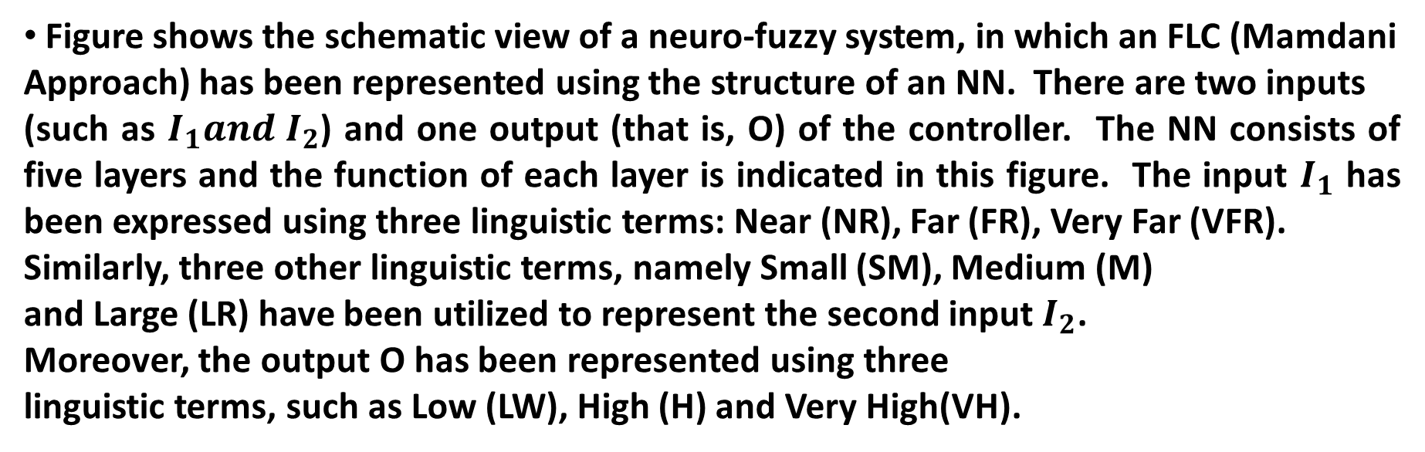
Numerical Example:
Figure shows the schematic view of a neuro-fuzzy system, in which an FLC (Mamdani
Approach) has been represented using the structure of an NN. There are two inputs
(such as $I_{1}and I_{2}$) and one output (that is, O) of the controller. The NN consists of five layers and the function of each layer is indicated in this figure. The input $I_{1}$ has been expressed using three linguistic terms: Near (NR), Far (FR), Very Far (VFR).
Similarly, three other linguistic terms, namely Small (SM), Medium (M)
and Large (LR) have been utilized to represent the second input $I_{2}$.
Moreover, the output O has been represented using three
linguistic terms, such as Low (LW), High (H) and Very High(VH).

Slide 34
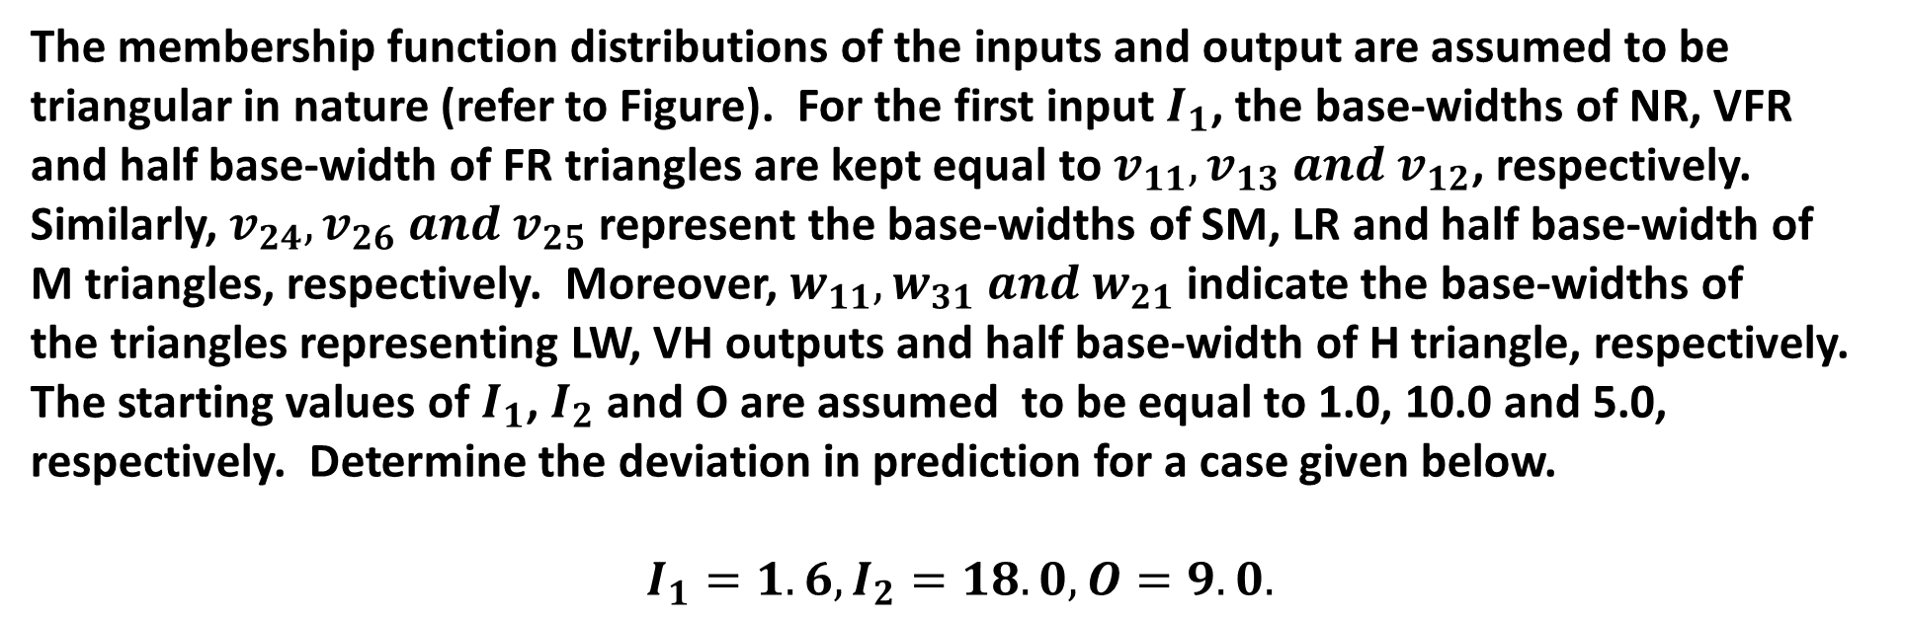
The membership function distributions of the inputs and output are assumed to be
triangular in nature (refer to Figure). For the first input $I_{1}$, the base-widths of NR, VFR
and half base-width of FR triangles are kept equal to $v_{11},v_{13} and{ v}_{12}$, respectively.
Similarly, $v_{24},v_{26} and{ v}_{25}$ represent the base-widths of SM, LR and half base-width of
M triangles, respectively. Moreover, $w_{11},w_{31} and{ w}_{21}$ indicate the base-widths of
the triangles representing LW, VH outputs and half base-width of H triangle, respectively.
The starting values of $I_{1}$, $I_{2}$ and O are assumed to be equal to 1.0, 10.0 and 5.0,
respectively. Determine the deviation in prediction for a case given below.
$$I_{1}=1.6,I_{2}=18.0, O=9.0.$$

Slide 35
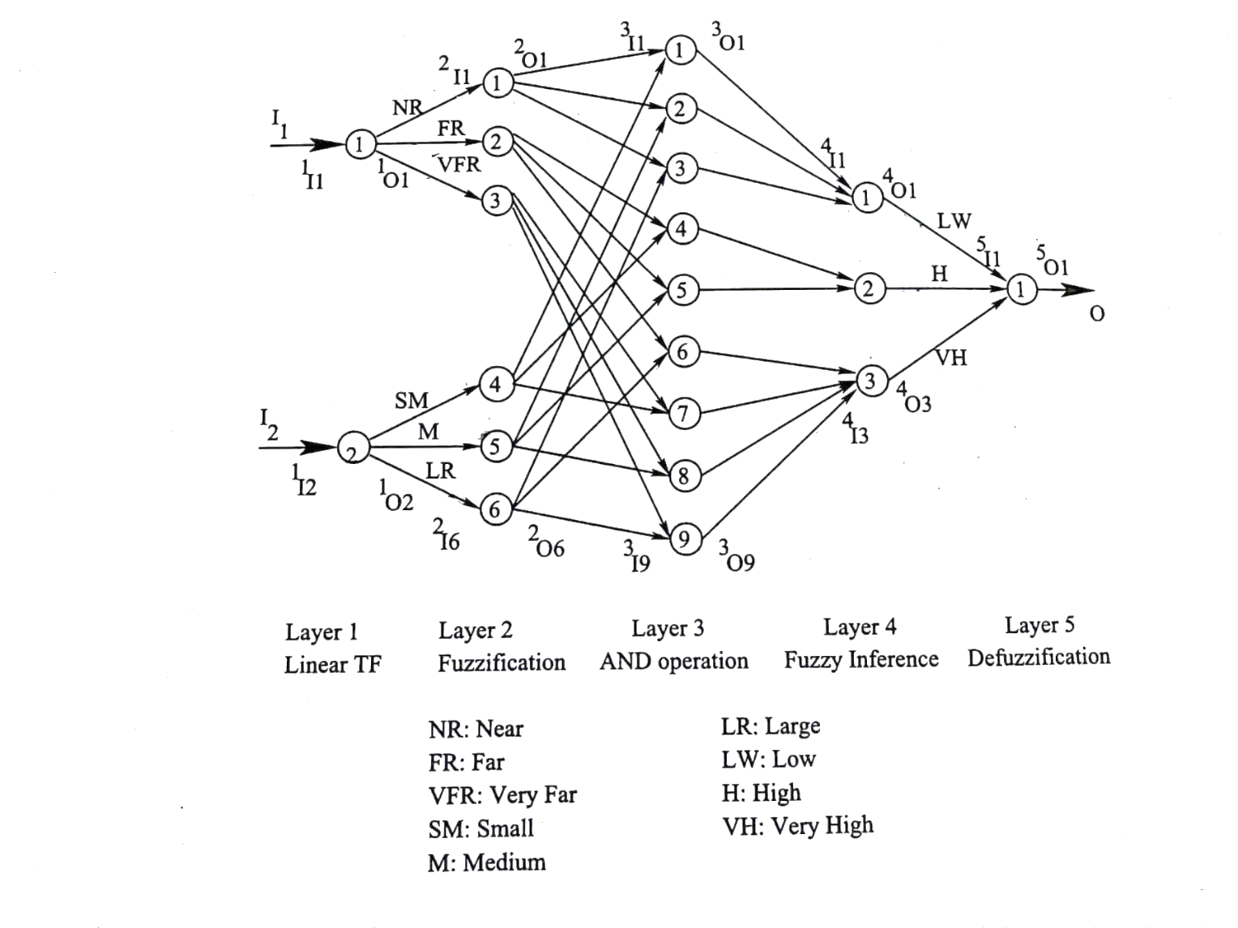
Figure: A neuro-fuzzy system.

Slide 36
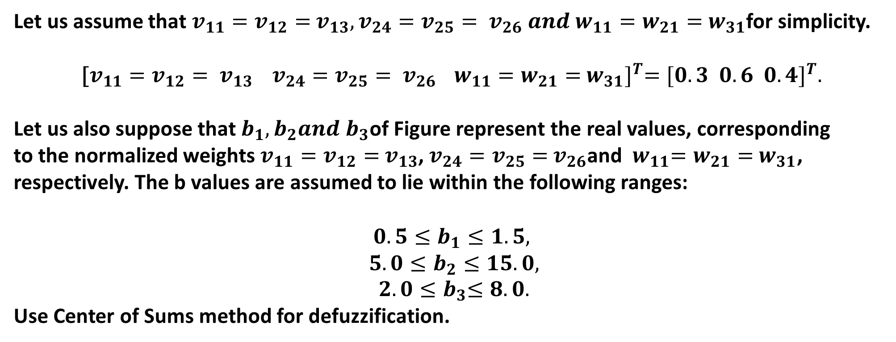
Let us assume that $v_{11}=v_{12}={ v}_{13},v_{24}=v_{25}={ v}_{26} and{ w}_{11}=w_{21}={ w}_{31}$for simplicity.
$${\text{[}v_{11}=v_{12}={ v}_{13} v_{24}=v_{25}={ v}_{26} { w}_{11}=w_{21}={ w}_{31}]}^{T}={[0.3 0.6 0.4]}^{T}.$$
Let us also suppose that $b_{1}, b_{2}and{ b}_{3}$of Figure represent the real values, corresponding
to the normalized weights $v_{11}=v_{12}={ v}_{13}$, $v_{24}=v_{25}={ v}_{26}$and ${ w}_{11}=w_{21}={ w}_{31}$,
respectively. The b values are assumed to lie within the following ranges:
$$0.5≤b_{1}≤1.5,$$
$${5.0≤b}_{2}≤15.0,$$
$${ 2.0≤b}_{3}≤8.0.$$
Use Center of Sums method for defuzzification.

Slide 37
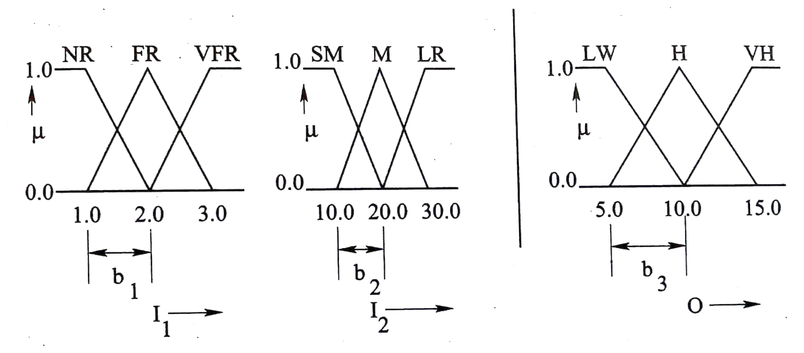
Solution:
Figure: Manually constructed membership function distributions of the variables

Slide 38
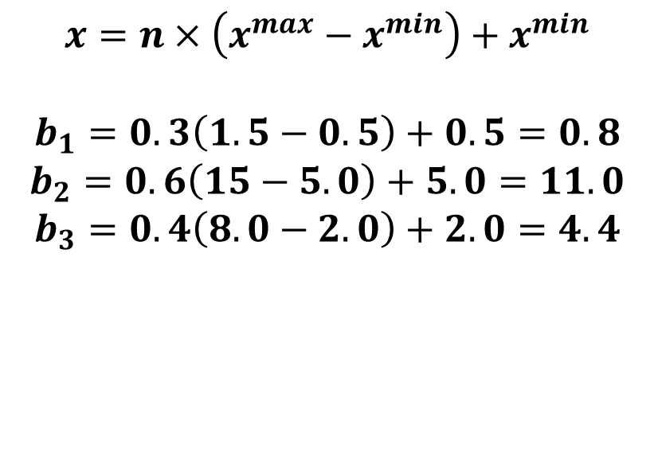
$$x=n×\left(x^{max}−x^{min}\right)+x^{min}$$
$$b_{1}=0.3\left(1.5−0.5\right)+0.5=0.8$$
$$b_{2}=0.6\left(15−5.0\right)+5.0=11.0$$
$$b_{3}=0.4\left(8.0−2.0\right)+2.0=4.4$$

Slide 39
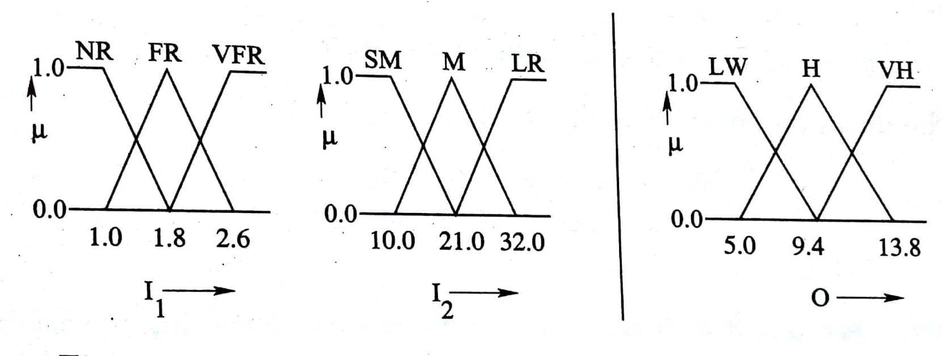
Figure: Modified membership function distributions of the variables

Slide 40
Rule Base
I₂
SM M LR
NR
FR
VFR
LW | LW | LW
H | H | VH
VH | VH | VH
I₁

Slide 41
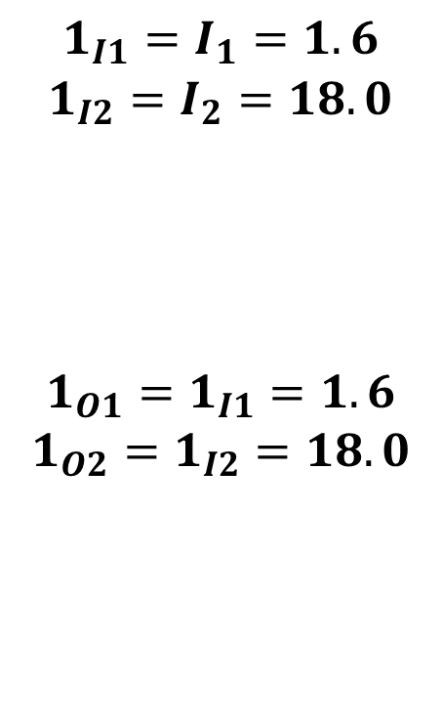
To determine output of the controller, input-output relationships of different
layers are calculated.
Layer 1:
$$1_{I1}=I_{1}=1.6$$
$$1_{I2}=I_{2}=18.0$$
$$1_{O1}=1_{I1}=1.6$$
$$1_{O2}=1_{I2}=18.0$$
As the neurons of first layer are assumed to have linear transfer function,
the outputs are calculated like the following:

Slide 42
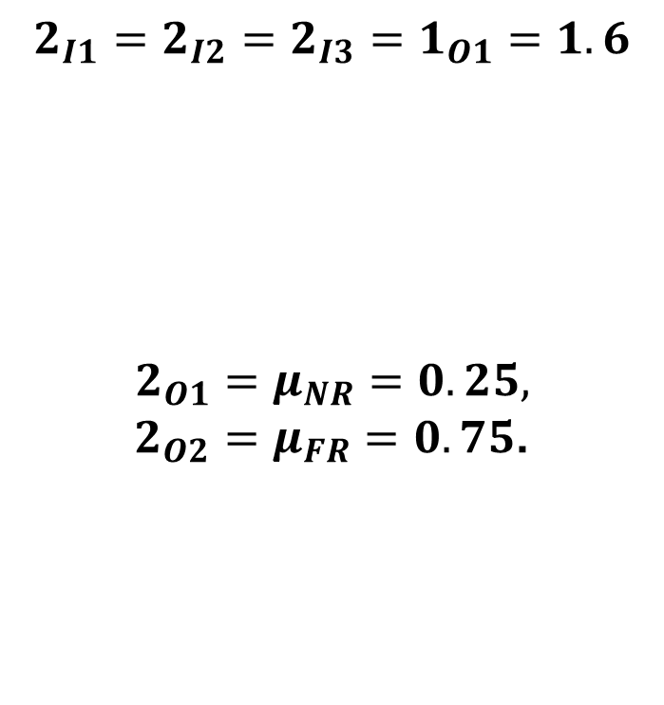
Layer 2:
$$2_{I1}=2_{I2}=2_{I3}=1_{O1}=1.6$$
$$2_{O1}=μ_{NR}=0.25,$$
$2_{O2}=μ_{FR}=0.75$.
The input $I_{1}$can be called either NR or FR. Therefore,

Slide 43
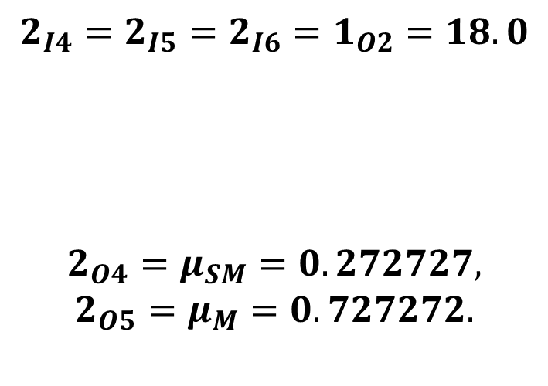
Similarly, we get
$$2_{I4}=2_{I5}=2_{I6}=1_{O2}=18.0$$
$$2_{O4}=μ_{SM}=0.272727,$$
$$2_{O5}=μ_{M}=0.727272.$$
The input $I_{2}$can be declared either SM or M. Therefore,

Slide 44
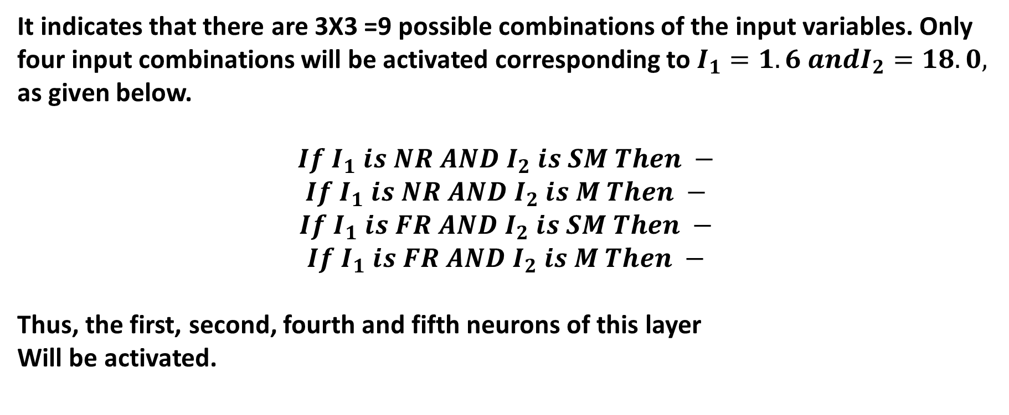
Layer 3:
It indicates that there are 3X3 =9 possible combinations of the input variables. Only
four input combinations will be activated corresponding to $I_{1}=1.6 andI_{2}=18.0,$
as given below.
$$If{ I}_{1} is NR AND I_{2} is SM Then −$$
$$If{ I}_{1} is NR AND I_{2} is M Then −$$
$$If{ I}_{1} is FR AND I_{2} is SM Then −$$
$$If{ I}_{1} is FR AND I_{2} is M Then −$$
Thus, the first, second, fourth and fifth neurons of this layer
Will be activated.

Slide 45
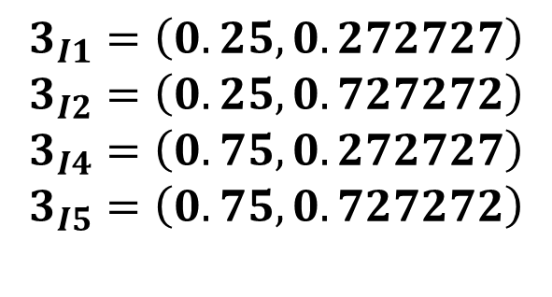
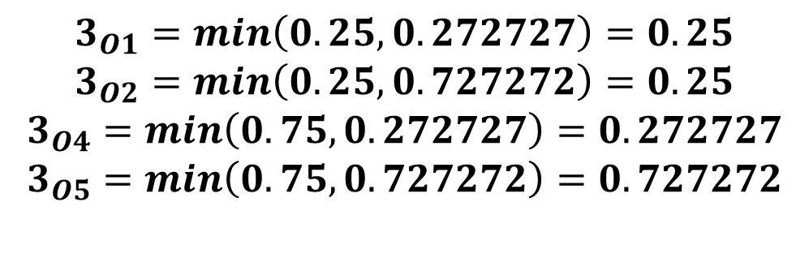
$$3_{I1}=\left(0.25,0.272727\right)$$
$$3_{I2}=\left(0.25,0.727272\right)$$
$$3_{I4}=\left(0.75,0.272727\right)$$
$$3_{I5}=\left(0.75,0.727272\right)$$
As this layer performs AND operation, the outputs of above neurons can be determined
like the following:
$$3_{O1}=min\left(0.25,0.272727\right)=0.25$$
$$3_{O2}=min\left(0.25,0.727272\right)=0.25$$
$$3_{O4}=min\left(0.75,0.272727\right)=0.272727$$
$$3_{O5}=min\left(0.75,0.727272\right)=0.727272$$

Slide 46
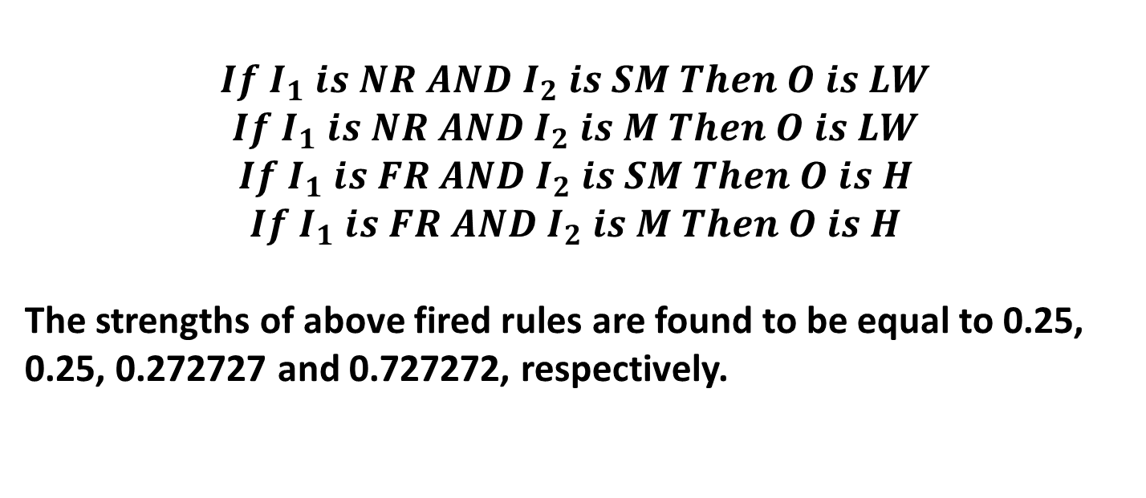
Layer 4:
It indicates the outputs (consequent parts) of the activated input combinations.
The output of this layer is nothing but the set of fired rules along with their
strengths. The following four rules will be fired:
$$If{ I}_{1} is NR AND I_{2} is SM Then O is LW$$
$$If{ I}_{1} is NR AND I_{2} is M Then O is LW$$
$$If{ I}_{1} is FR AND I_{2} is SM Then O is H$$
$$If{ I}_{1} is FR AND I_{2} is M Then O is H$$
The strengths of above fired rules are found to be equal to 0.25, 0.25, 0.272727 and 0.727272, respectively.

Slide 47
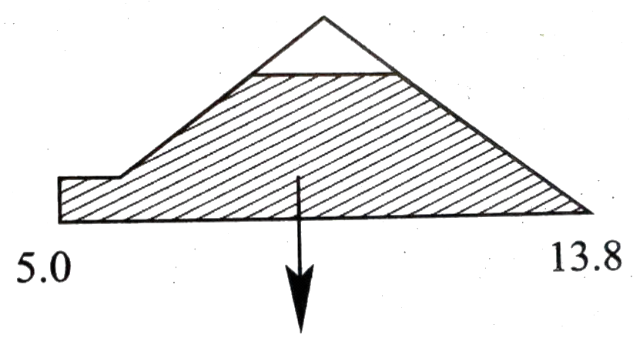
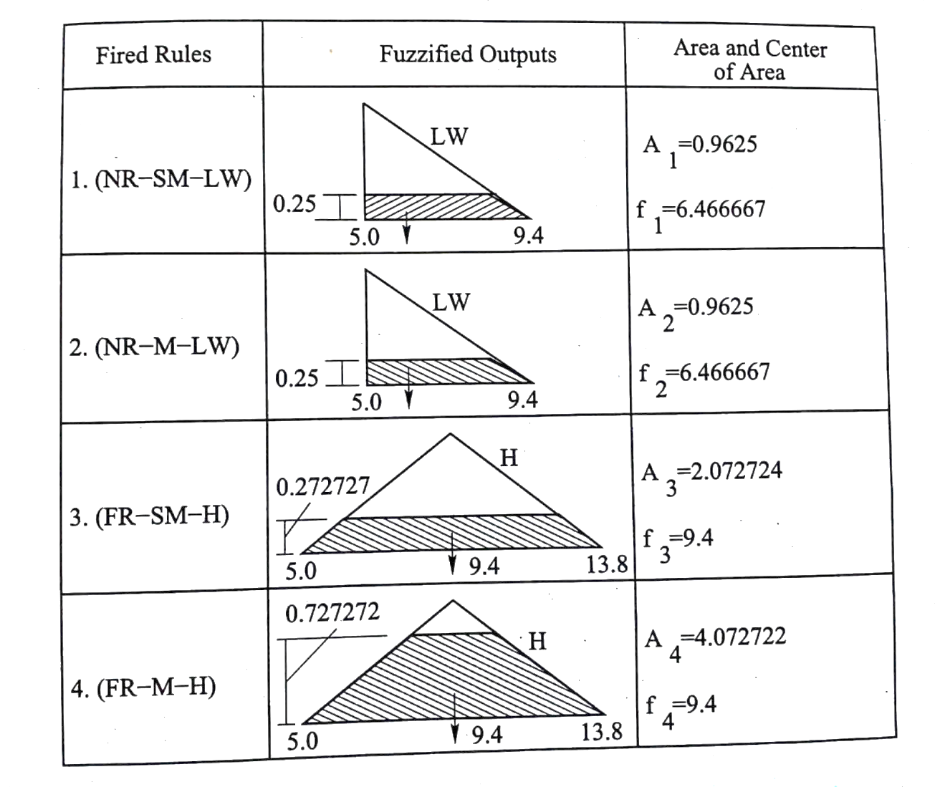
Figure: Fuzzified outputs of different fired rules
Combined Fuzzified Output

Slide 48
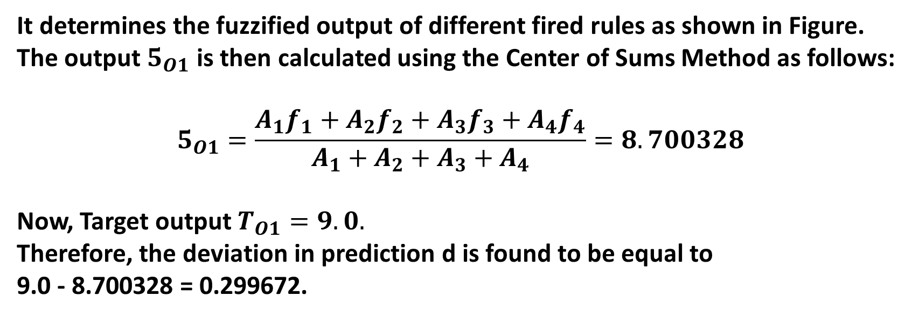
Layer 5:
It determines the fuzzified output of different fired rules as shown in Figure.
The output $5_{O1}$ is then calculated using the Center of Sums Method as follows:
$$5_{O1}=\frac{A_{1}f_{1}+A_{2}f_{2}+A_{3}f_{3}+A_{4}f_{4}}{A_{1}+A_{2}+A_{3}+A_{4}}=8.700328$$
Now, Target output $T_{O1}=9.0.$
Therefore, the deviation in prediction d is found to be equal to
9.0 - 8.700328 = 0.299672.

Slide 49
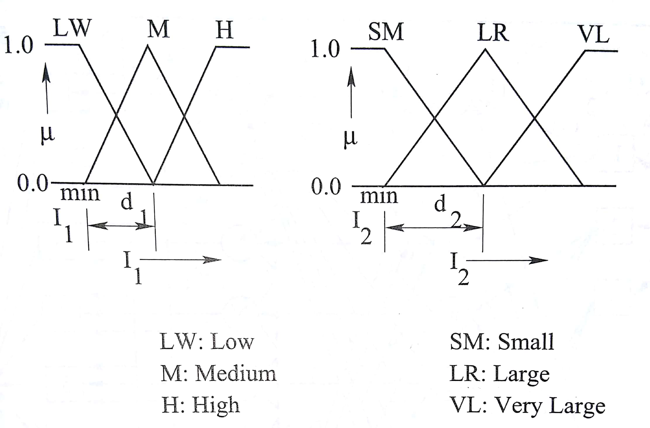
Neuro-Fuzzy System Based On Takagi and Sugeno’s Approach
It is also known as Adaptive Neuro-Fuzzy Inference System (ANFIS)
Proposed by Jang, 1993
Let us consider a process with two inputs: I₁ and I₂ and one output: O
Membership function distributions of input variables

Slide 50
According to first-order Takagi and Sugeno’s model of FLC
y^{i} = a_{i}I₁+b_{i}I₂+c_{i} ,
where i = 1, 2, . . . . ., 9
a_{i}, b_{i}, c_{i} are coefficients

Slide 51
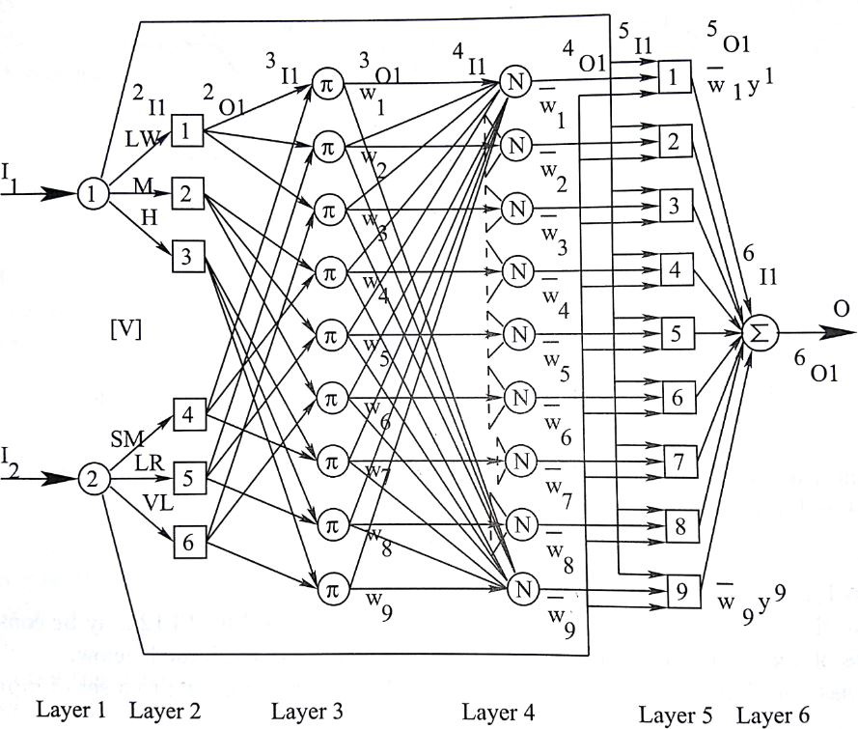
ANFIS architecture

Slide 52
Let us assume that the following 4 rules are fired,
corresponding to a set of inputs: I₁* and I₂*
If I₁ is LW and I₂ is SM the y₁ = a₁I₁+b₁I₂+c₁
If I₁ is LW and I₂ is LR then y₂ = a₂I₁+b₂I₂+c₂
If I₁ is M and I₂ is SM then y₄ = a₄I₁+b₄I₂+c₄
If I₁ is M and I₂ is LR then y₅ = a₅I₁+b₅I₂+c₅

Slide 53
Layer 1:
Layer 2:
Layer 3:
Layer 4:
Linear TF (output = input)
1_{O1} = 1_{I1} = I₁*
1_{O2} = 1_{I2} = I₂*
Fuzzification
Firing strengths of the rules are calculated considering the products of μ values
w₁ = μ_{LW} (I₁*) X μ_{SM}(I₂*)
Similarly, we get w₂, w₄ and w₅
Calculate normalized firing strength of each rule
Similarly, we get

Slide 54
Layer 5:
Layer 6:
Note:
Output is calculated as the product of normalized firing strength and output of the corresponding fired rule y
Overall output
Performance depends on membership function distributions of input variables: a_{i}, b_{i}, c_{i}
Tuning of ANFIS GA Genetic Neuro-Fuzzy System

Slide 55
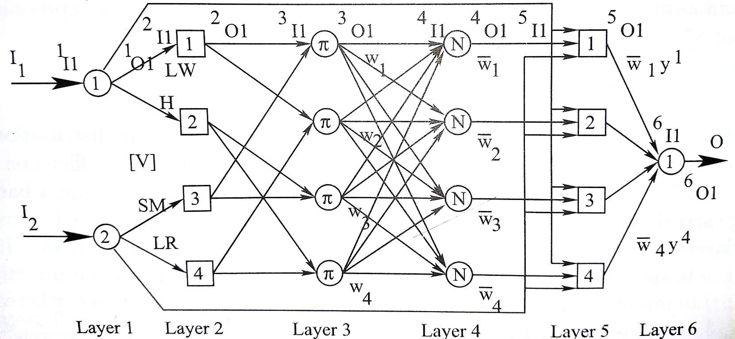
Numerical Example
Below figure shows the schematic view of an ANFIS used to model a process having two inputs: I₁ , I₂ and one output O. The network consists of six layers. Two linguistic terms, such as LW (Low) and H (High) have been utilized to represent first input I₁. Similarly, the second input I₂ has been expressed using two other linguistic terms, namely SM (Small) and LR (Large).

Slide 56
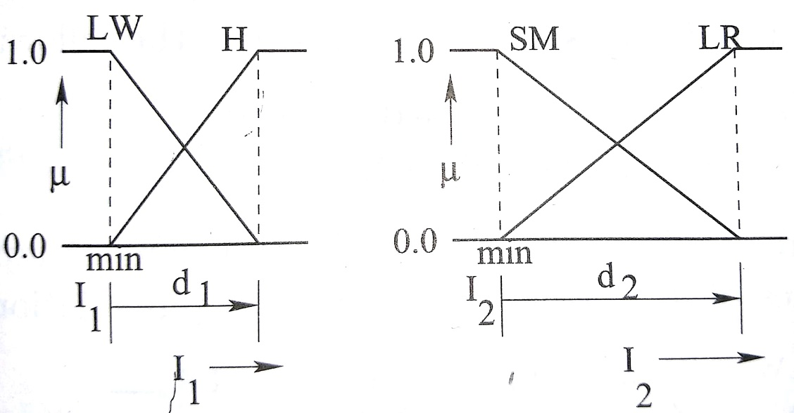
The connecting weights (expressed in the normalized form from 0.0 to 1.0) between the nodes of first and second layers are denoted by [V] matrix. The membership function distributions of the input variables are assumed to be triangular in nature.
The starting values of I₁ ( that is , I₁^{min} ) and I₂ ( that is, I₂^{min} ) are assumed to be equal to 1.0 unit and 5.0 units, respectively. For the first input I₁ , the base width of LW and H right-angled triangles is kept equal to d₁ .

Slide 57
Similarly, d₂ represents the base-width of SM and LR right-angled triangles. For simplicity, it has been assumed that v₁₁ = v₁₂ and v₂₃ = v_{24 .}
Moreover, d₁ and d₂ indicate the real values corresponding to the normalized weights v₁₁ = v₁₂ and v₂₃ = v_{24 ,} respectively. As there are only two inputs and two linguistic terms have been utilized to represent each variable, there is a maximum of 2×2 = 4 possible rules.
According to the first-order Takagi and Sugeno’s model of FLC ,
the rules can be expressed as follows:
y^{i} = a_{i}I₁+b_{i}I₂+c_{i ,}
where i = 1, 2, 3, 4 ; a_{i}, b_{i}, c_{i} are the coefficients of the rules.

Slide 58
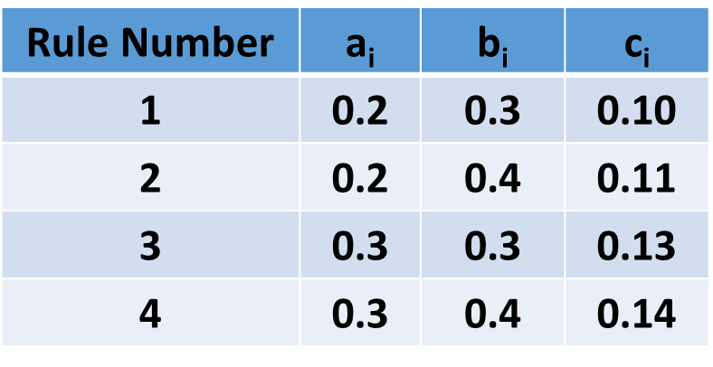
The values of d₁ and d₂ vary in the ranges as below.
0.8≤ d₁ ≤ 1.5 ; 4.0≤ d₂ ≤ 6.0 .
Assume the normalized weight values as follows:
[ v₁₁ = v₁₂ v₂₃ = v₂₄ ]^{T} = [0.3 0.5]^{T}
and determine the deviation in prediction for the training scenario .
I₁ = 1.1, I₂ = 6.0 and Output O = 2.3 .

Slide 59
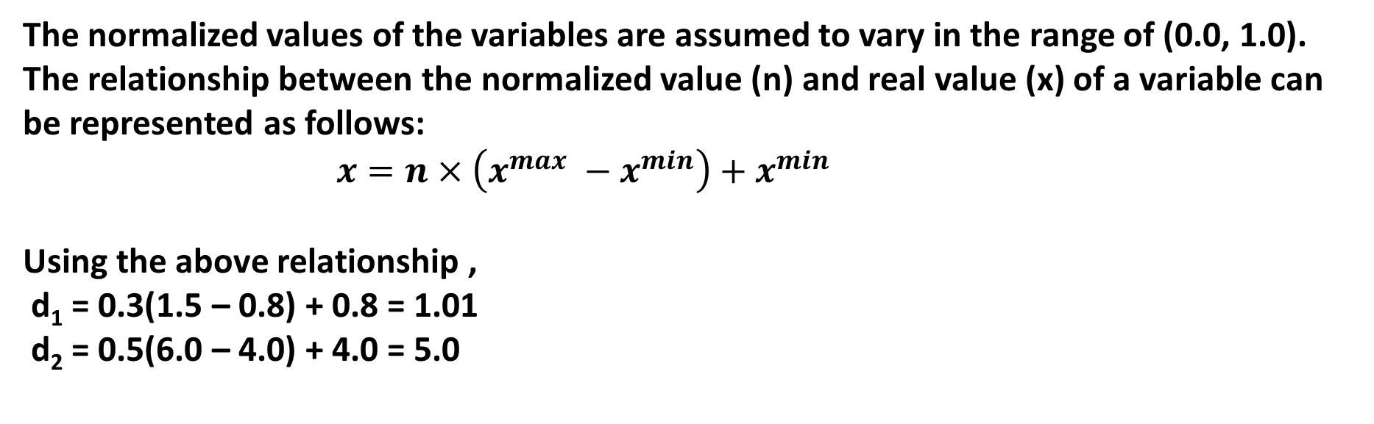
Solution:
The normalized values of the variables are assumed to vary in the range of (0.0, 1.0). The relationship between the normalized value (n) and real value (x) of a variable can be represented as follows:
$x=n×\left(x^{max} −x^{min}\right)+x^{min}$
Using the above relationship ,
d₁ = 0.3(1.5 – 0.8) + 0.8 = 1.01
d₂ = 0.5(6.0 – 4.0) + 4.0 = 5.0

Slide 60
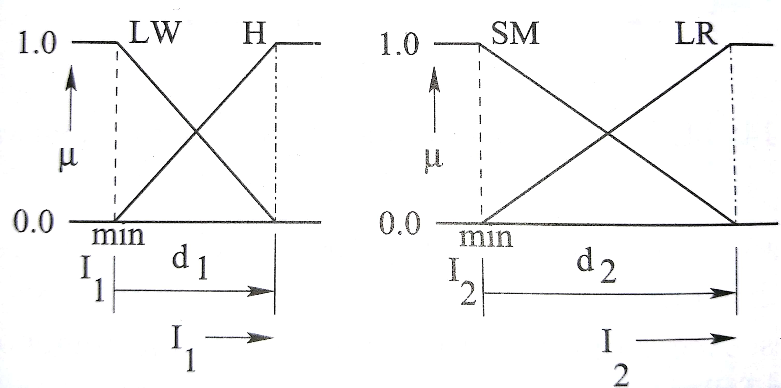
Modified membership function distributions of input variables, corresponding to the above values of d₁ and d₂ are shown below:

Slide 61
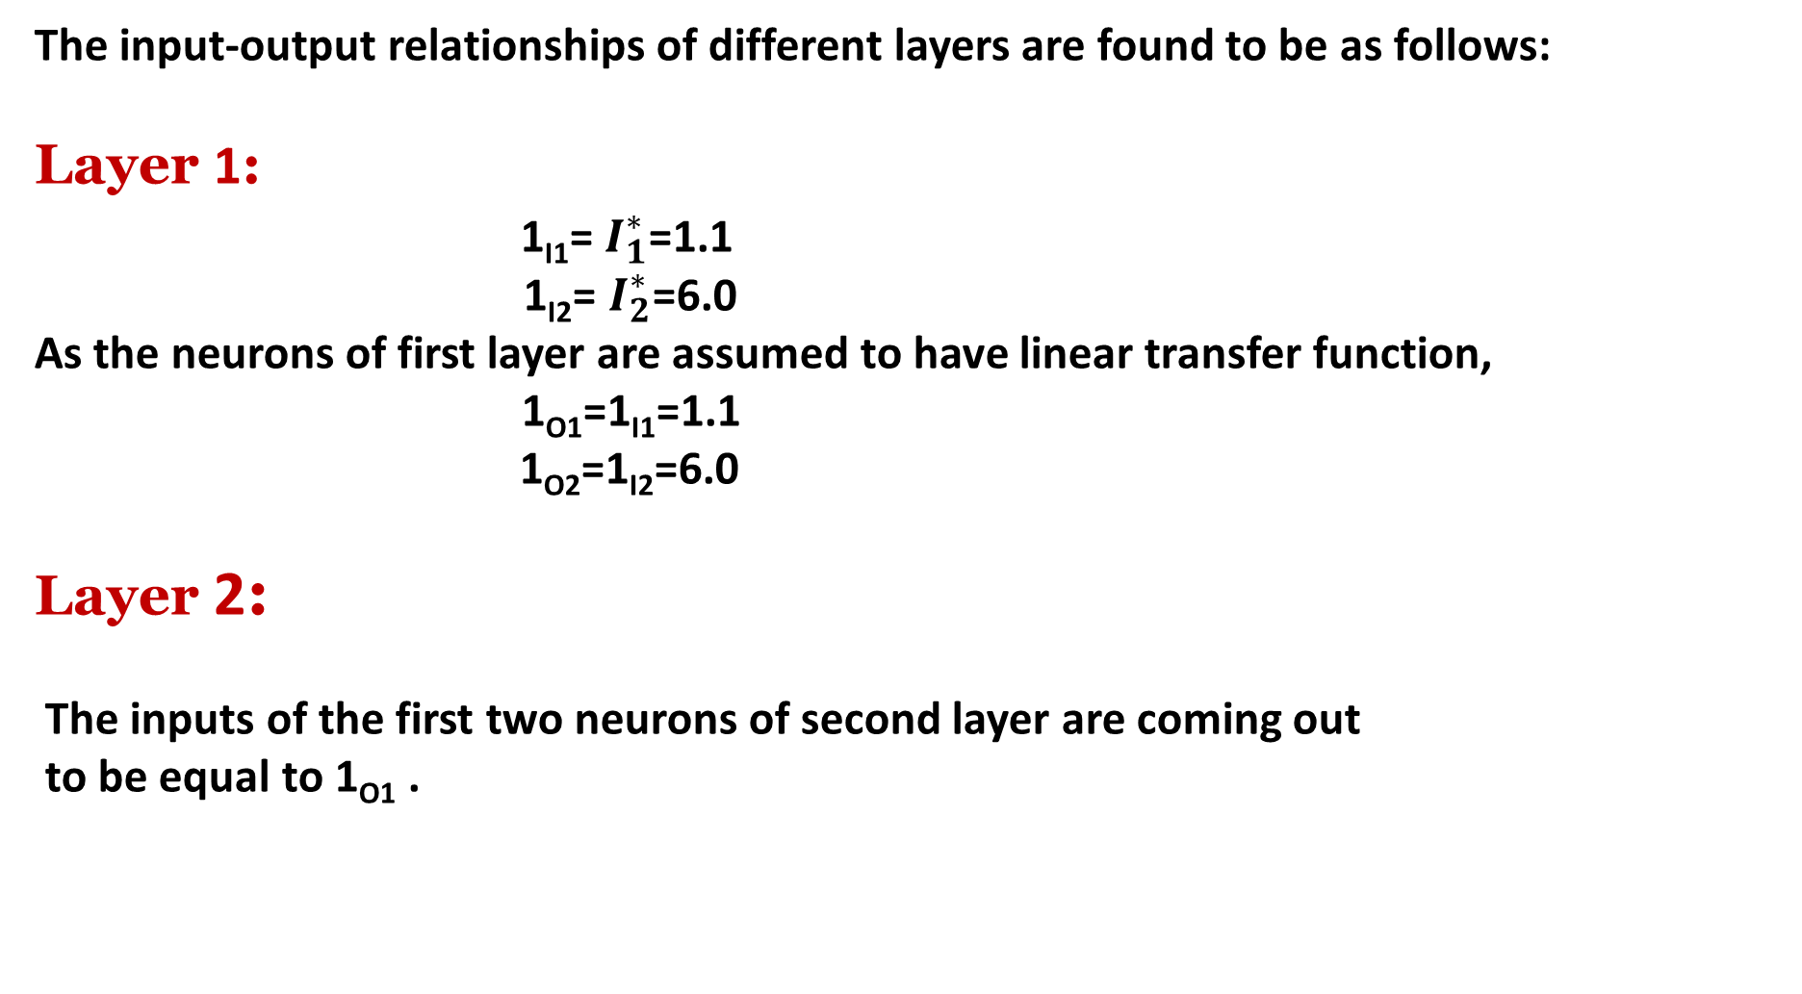
The input-output relationships of different layers are found to be as follows:
Layer 1:
1_{I1}= $I_{1}^{∗}$=1.1
1_{I2}= $I_{2}^{∗}$=6.0
As the neurons of first layer are assumed to have linear transfer function,
1_{O1}=1_{I1}=1.1
1_{O2}=1_{I2}=6.0
Layer 2:
The inputs of the first two neurons of second layer are coming out
to be equal to 1_{O1} .

Slide 62
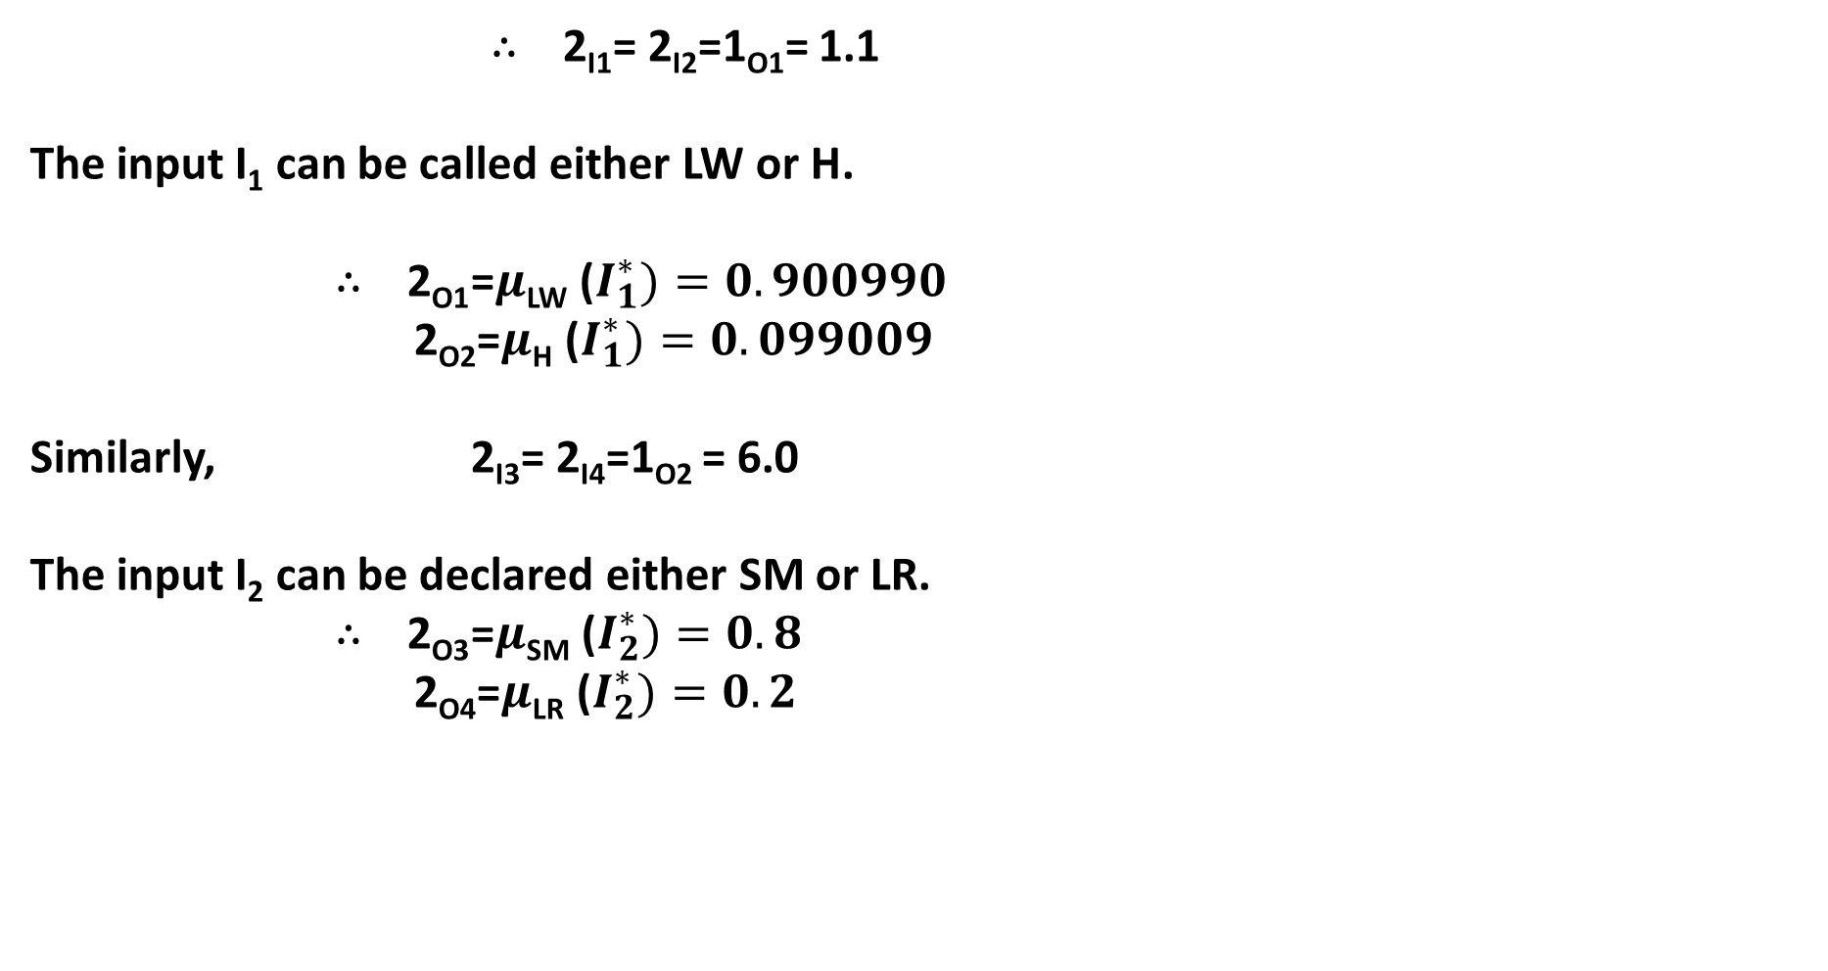
$∴$ 2_{I1}= 2_{I2}=1_{O1}= 1.1
The input I₁ can be called either LW or H.
$∴$ 2_{O1} =$μ$_{LW} ($I_{1}^{∗})=0.900990$
2_{O2}=$μ$_{H} ($I_{1}^{∗})=0.099009$
Similarly, 2_{I3}= 2_{I4}=1_{O2} = 6.0
The input I₂ can be declared either SM or LR.
$∴$ 2_{O3} =$μ$_{SM} ($I_{2}^{∗})=0.8$
2_{O4}=$μ$_{LR} ($I_{2}^{∗})=0.2$

Slide 63
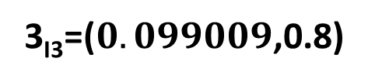
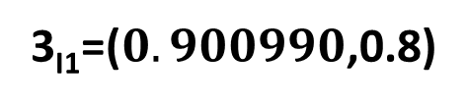
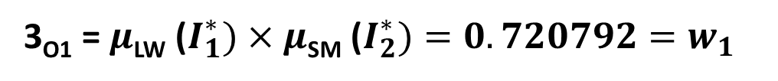
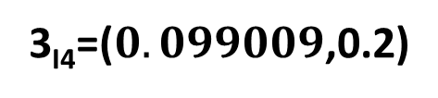
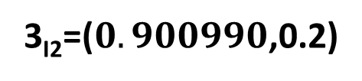
Layer 3:
Corresponding to the inputs I₁ = 1.1, I₂ = 6.0, all possible four rules will be fired and their inputs and outputs are given below.
3_{I1}=($0.900990$,0.8)
3_{I2}=($0.900990$,0.2)
3_{I3}=($0.099009$,0.8)
3_{I4}=($0.099009$,0.2)
As this layer performs multiplication operation, the outputs of the above neurons can be determined like the following:
3_{O1} = $μ$_{LW} ($I_{1}^{∗})×μ\text{SM}\text{ (}I_{2}^{∗})=0.720792=w_{1}$

Slide 64
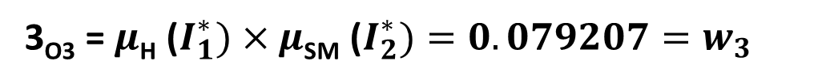
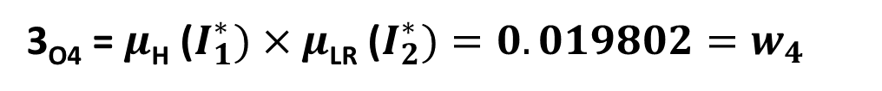

Layer 3:
3_{O2} = $μ$_{LW} ($I_{1}^{∗})×μ\text{LR}\text{ (}I_{2}^{∗})=0.180198=w_{2}$
3_{O3} = $μ$_{H} ($I_{1}^{∗})×μ\text{SM}\text{ (}I_{2}^{∗})=0.079207=w_{3}$
3_{O4} = $μ$_{H} ($I_{1}^{∗})×μ\text{LR}\text{ (}I_{2}^{∗})=0.019802=w_{4}$
Layer 4:
The normalized firing strengths can be calculated as follows:

Slide 65
Layer 4:
Layer 5:

Slide 66

Layer 5:
Layer 6:
The overall output 6_{O1} can be calculated as follows:
Now, Target output T_{O1} = 2.3
$∴$ Deviation in prediction = 2.3 – 2.255860 = 0.044140

Slide 67
Conclusion:
Principles of Neuro-Fuzzy Systems (both Mamdani Approach as well as Takagi and Sugeno’s Approach) have been discussed with suitable numerical examples

